Slide 1

A Passive Intrusion into Analytical Graphics Inc.
Devin Trejo
devin.trejo@temple.edu
20160208

Slide 2
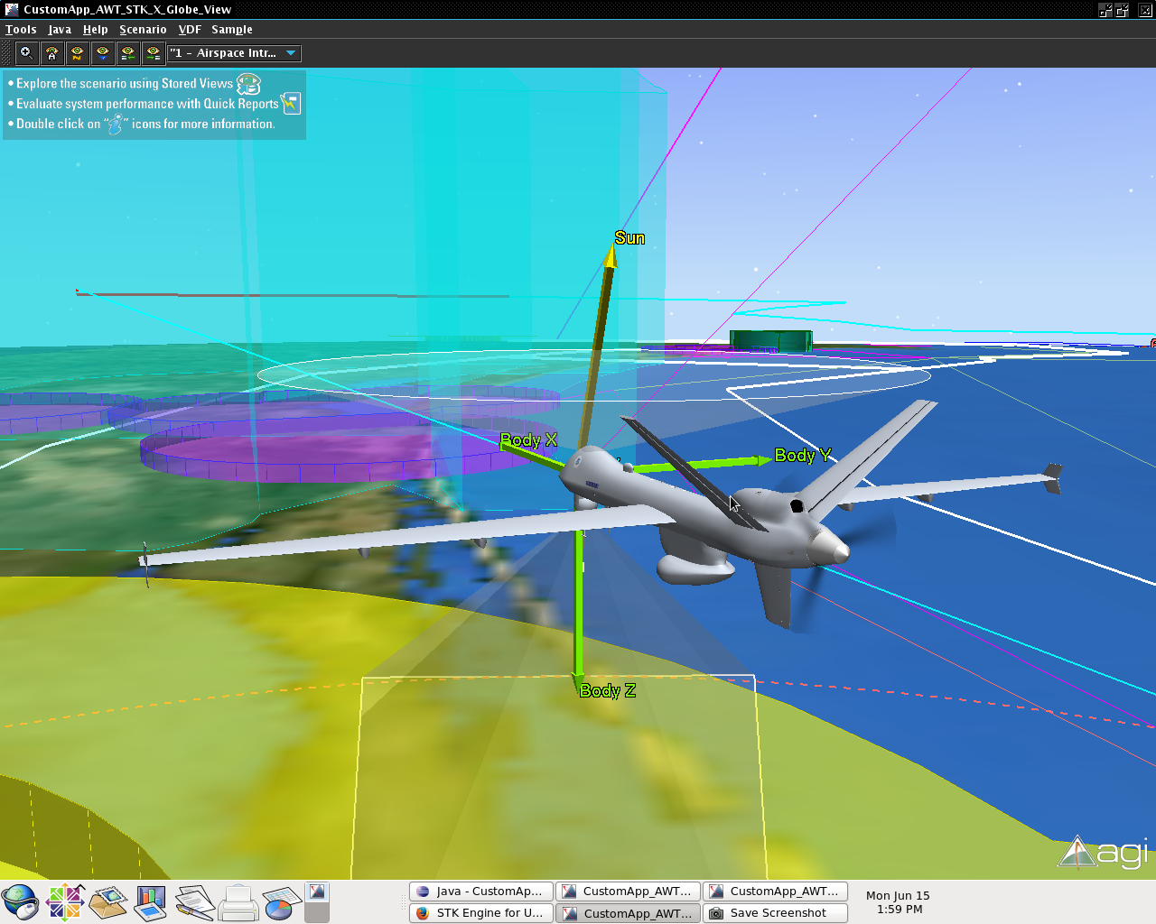
Overview
Background Company Information
Passive Information Gathering Methods
Passive Information Gathering Results
A Quick Active? Information Gathering Result
Concluding Summary

Slide 3

Background Company Information
What can we find with a typical Google Search?

Slide 4

Background Company Information Wikipedia
“Analytical Graphics, Inc. (AGI) develops commercial modeling and analysis software for the aerospace, defense and intelligence communities. AGI software is used by more than 50,000 engineers, operators and analysts worldwide.
Founded in 1989, AGI's nearly 200 employees are spread between the international headquarters in Exton, Pennsylvania, with satellite offices in Washington, D.C., Colorado Springs, CO, Long Beach, CA, the UK and Singapore.[1] The current CEO is Paul Graziani.[2]” -- (Wikipedia)

Slide 5

Passive Information Gathering Methods
Tools Used In This Analysis.

Slide 6
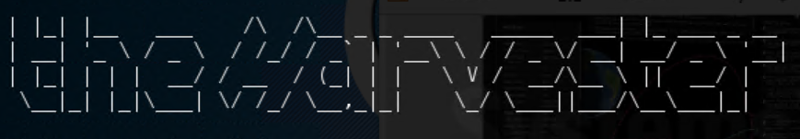

Passive Information Gathering Methods
The Harvester
Whois
“The objective of this program is to gather emails, subdomains, hosts, employee names, open ports and banners from different public sources like search engines, PGP key servers and SHODAN computer database.” --(tools.kali.org/)
“Whois is a query and response protocol that is widely used for querying databases that store the registered users or assignees of an Internet resource, such as a domain name, an IP addressblock, or an autonomous system, but is also used for a wider range of other information.” -- (Wikipedia)

Slide 7


Passive Information Gathering Methods
SSL Certificates
Forum Searching
We look to see if they have a site still running insecure connections to see if we can implement a man in the middle attack.
Look for forums where system administrators talk about their systems. Also find other resources the internal group may unitize.

Slide 8
Passive Information Gathering Results
What we found in our Passive Information Gathering.

Slide 9
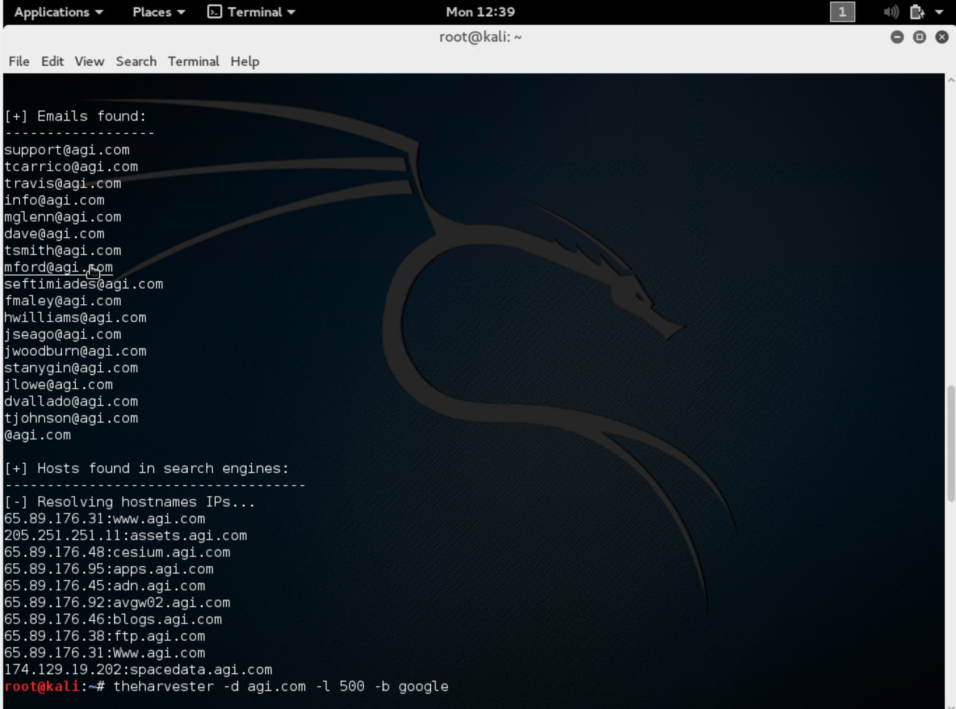
Passive Penetration Results The Harvester
Summary:
18 Emails
10 Sub-Domains:
Internal IP Address Space: 65.89.176.XXX
Other Addresses: 205.251.251.11, 174.129.19.202

Slide 10
Passive Penetration Results Whois: agi.com
Admin Details
Name: Downs, David
Street: 220 Valley Creek Blvd
City: Exton
State/Province: PA
Postal Code: 19341
Country: US
Phone: +1.6109818000
Email: dnsadmin@agi.com
Tech Details:
<same as admin>
Important Dates
Updated Date: 2015-09-02
Created Date: 1994-09-07
Registration Expiration Date: 2016-09-06
Nameservers
ns3.broadwing.net - 216.140.16.252
ns4.broadwing.net - 216.140.17.252
Registrar:
NETWORK SOLUTIONS, LLC. - http://www.networksolutions.com/
Summary:
David Downs is a probably a head administrator
Server has been around since 1994

Slide 11
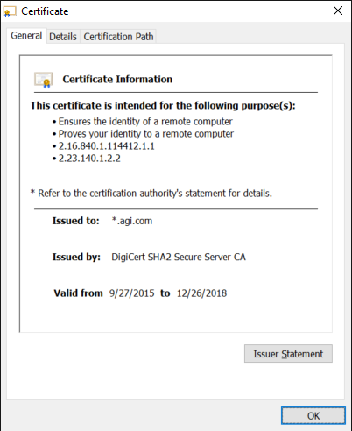
Passive Penetration Results SSL Certificate agi.com
Summary:
Using a wildcard certificate for all sub-domains. Expect secure communications between client and server.

Slide 12
Passive Penetration Results Whois: 205.251.251.11
NetRange: 205.251.192.0 - 205.251.255.255
CIDR: 205.251.192.0/18
NetName: AMAZON-05
NetHandle: NET-205-251-192-0-1
Parent: NET205 (NET-205-0-0-0-0)
NetType: Direct Allocation
OriginAS: AS16509, AS39111, AS7224
Organization: Amazon.com, Inc. (AMAZON-4)
RegDate: 2010-08-27
Updated: 2015-09-24
Summary:
They use Amazon Cloud EC2 instance for holding software assets
BG:
Amazon EC2 instances are grouped into 5 families: “General Purpose, Compute Optimized, Memory Optimized, GPU, and Storage Optimized instances” -- (Amazon)

Slide 13
Passive Penetration Results Whois: 174.129.19.202
NetRange: 174.129.0.0 - 174.129.255.255
CIDR: 174.129.0.0/16
NetName: AMAZON-EC2-5
NetHandle: NET-174-129-0-0-1
Parent: NET174 (NET-174-0-0-0-0)
NetType: Direct Allocation
OriginAS:
Organization: Amazon.com, Inc. (AMAZO-4)
RegDate: 2008-08-08
Updated: 2014-09-03
Summary:
They use another Amazon Cloud EC2 instance for holding space data assets.

Slide 14
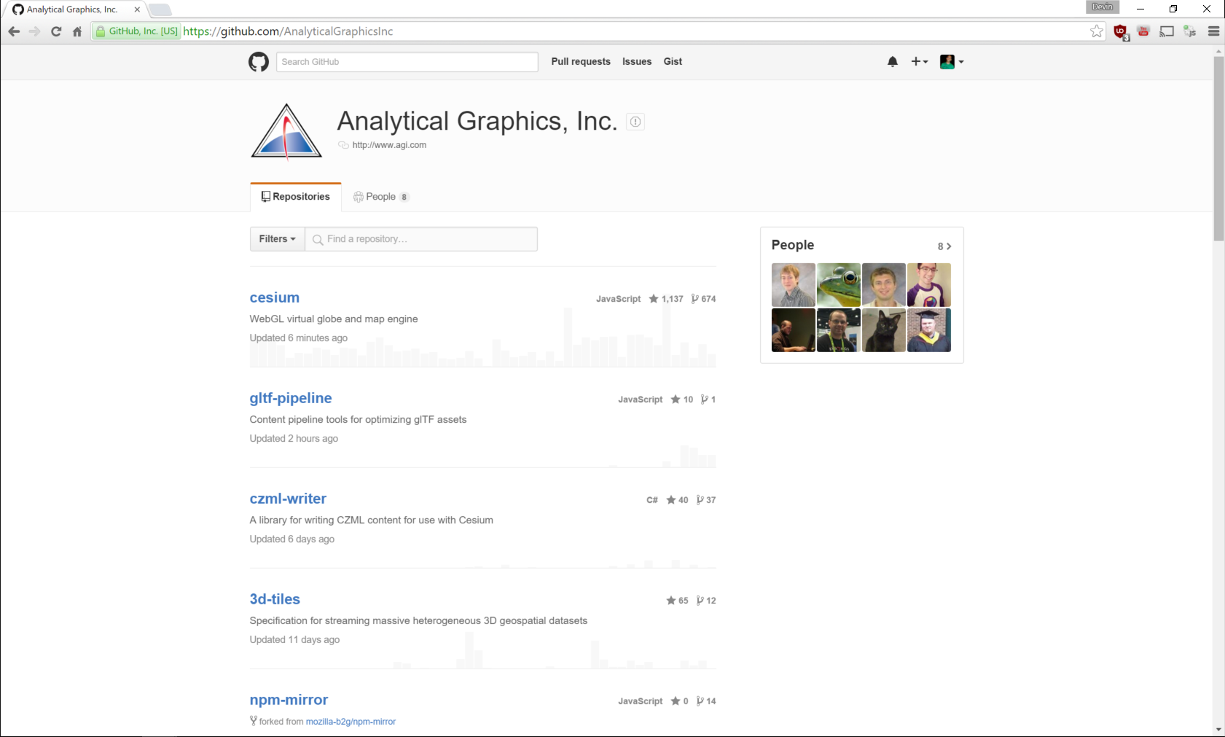
Passive Penetration Results Forum Searching
Summary:
They have multiple GitHub repositories that we can search for possible server-side misconfiguration leading to vulnerabilities we can exploit.

Slide 15
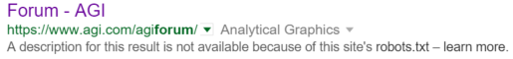
Passive Penetration Results Forum Searching
Summary:
We can not use a search engine on their internal forum page since they have configured the site not to respond to web crawler.

Slide 16
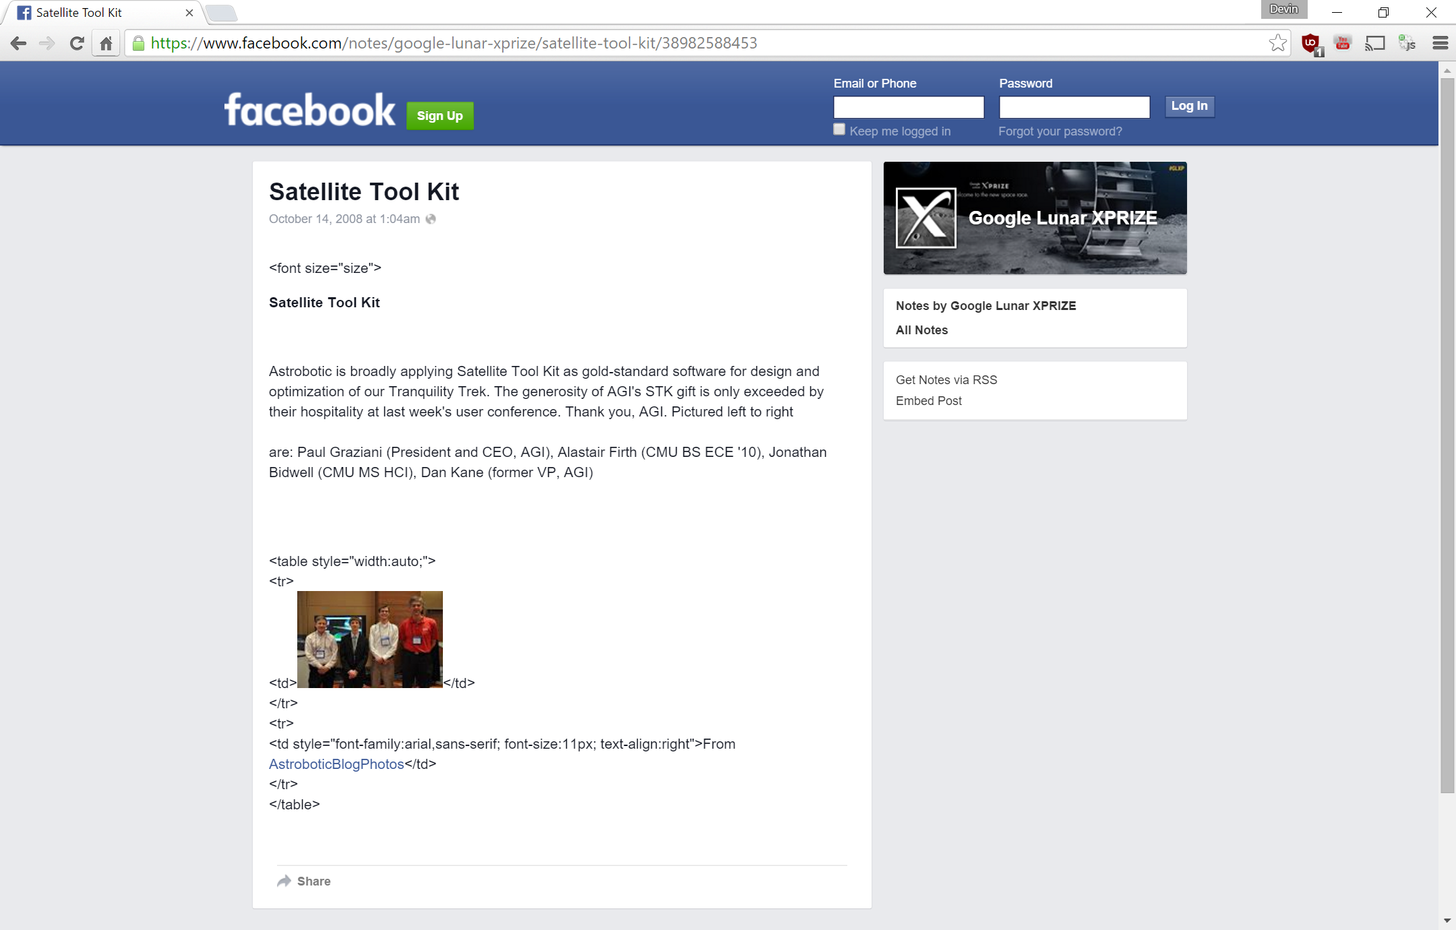
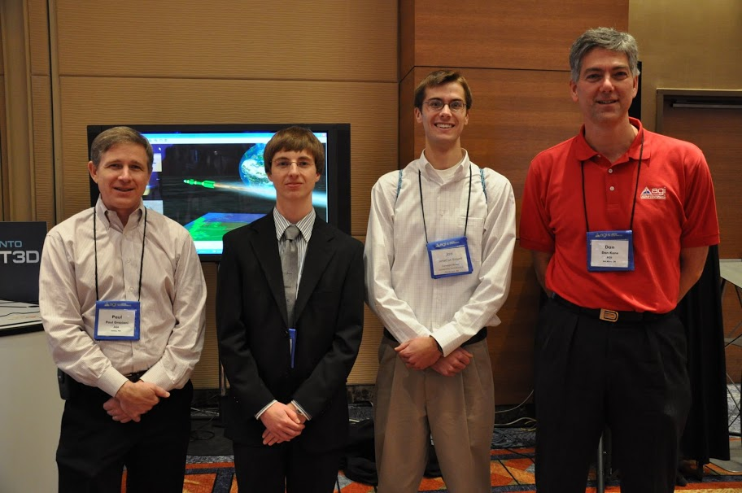
Passive Penetration Results People Search
Recall from Wikipedia the current CEO is Paul Graziani.
Facebook Search Term: AGI OR "Analytical Graphics" "Paul Graziani" site:facebook.com
We find he attend Google Lunar xPrize in 2008.
We also find he won Aviation Week, “for donating software licenses to educational institutions and encouraging students to pursue science, technology, engineering and math” (Facebook)

Slide 17
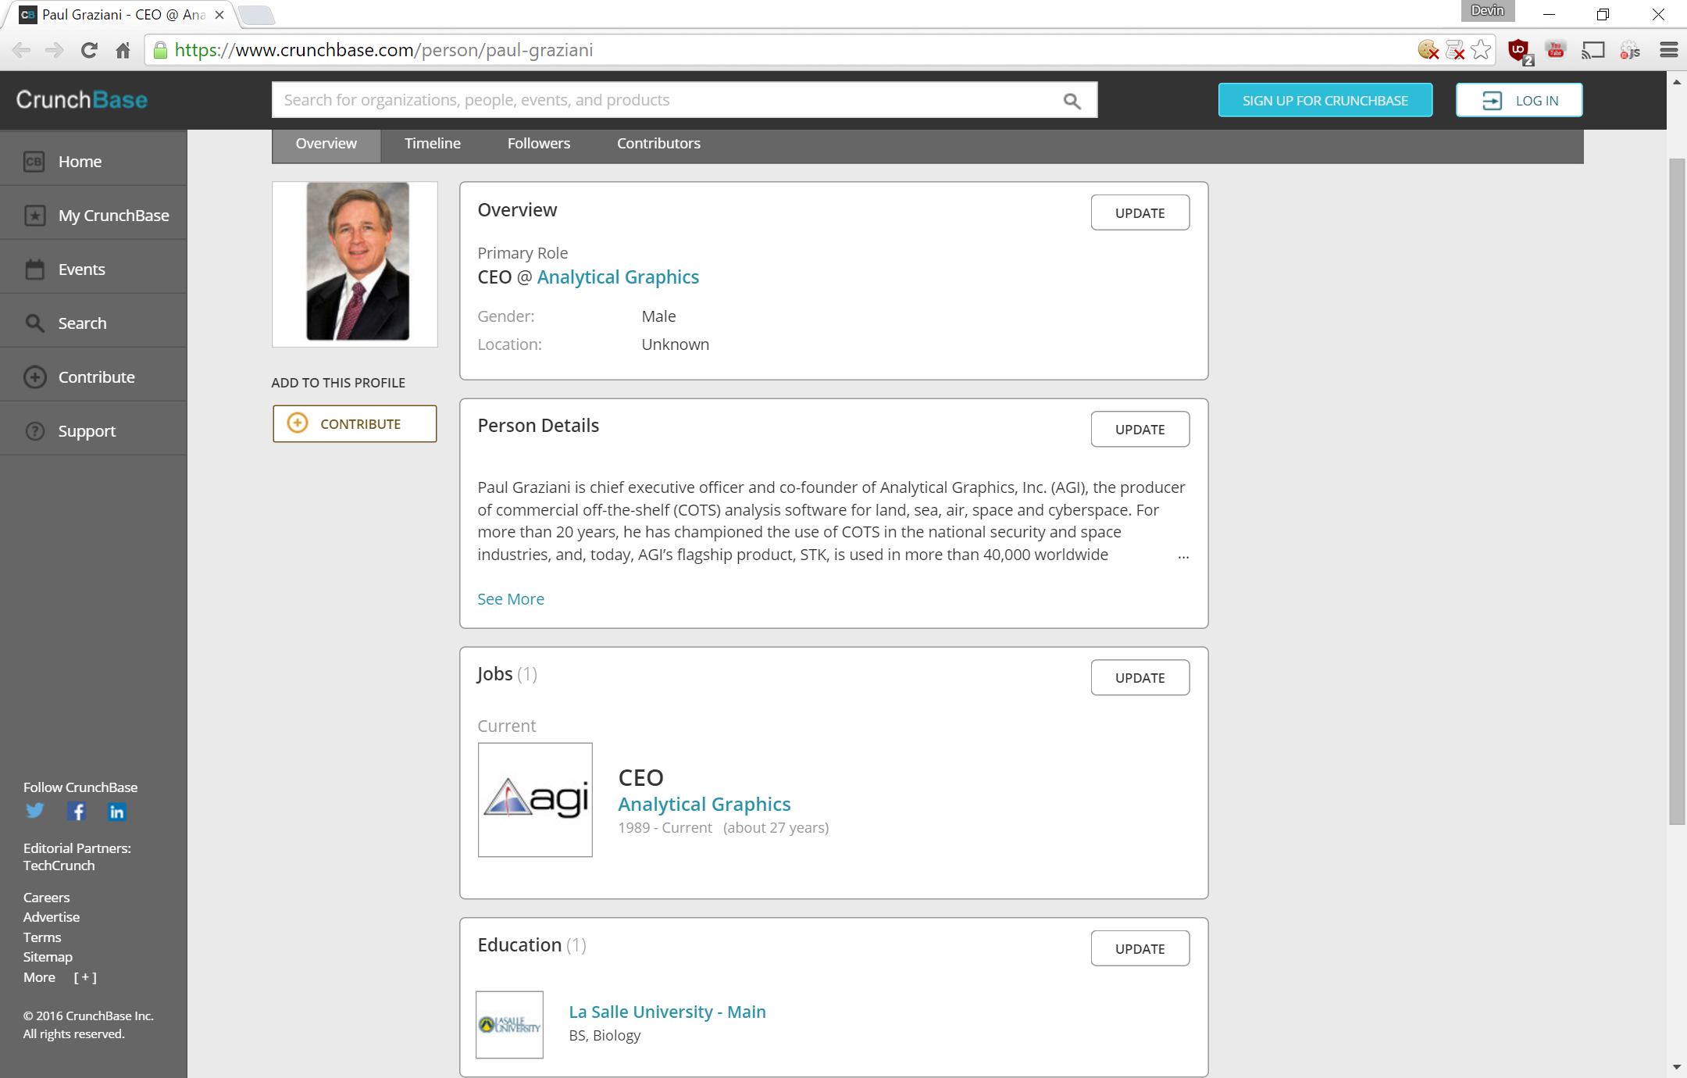
Passive Penetration Results People Search
Google Search Search Term: AGI OR "Analytical Graphics" "Paul Graziani" -agi.com
CrunchBase:
Atteneded La Salle University an obtinaed a BS in Biology
The Google results leads to him winning many other rewards.

Slide 18
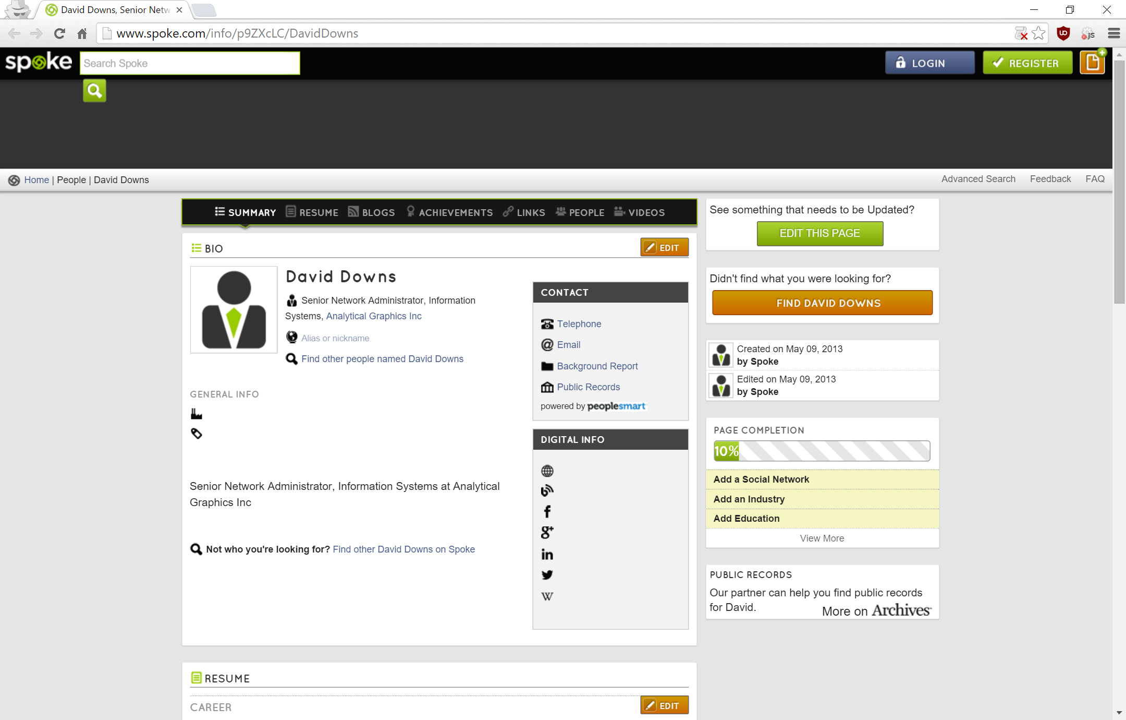
Passive Penetration Results People Search
Recall from the Whois result:
Google Search Term: "David Downs" AGI OR "Analytical Graphics" -agi.com
Spoke:
Senior Network Administrator, Information Systems at Analytical Graphics Inc.

Slide 19
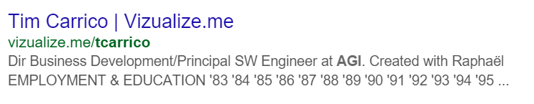
Passive Penetration Results People Search
Recall from the Harvester Results a list of emails.
First email: tcarrico@agi.com
Google Search Term: "tcarrico" AGI OR "Analytical Graphics" -agi.com
We find his full name to be “Tim Carrico” – Business Development and Principle Software Engineer at AGI

Slide 20
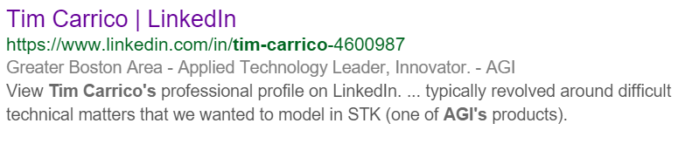
Passive Penetration Results People Search
No Facebook
Does have a Linkedin page but we can not browse anonymously thanks again to robots.txt

Slide 21
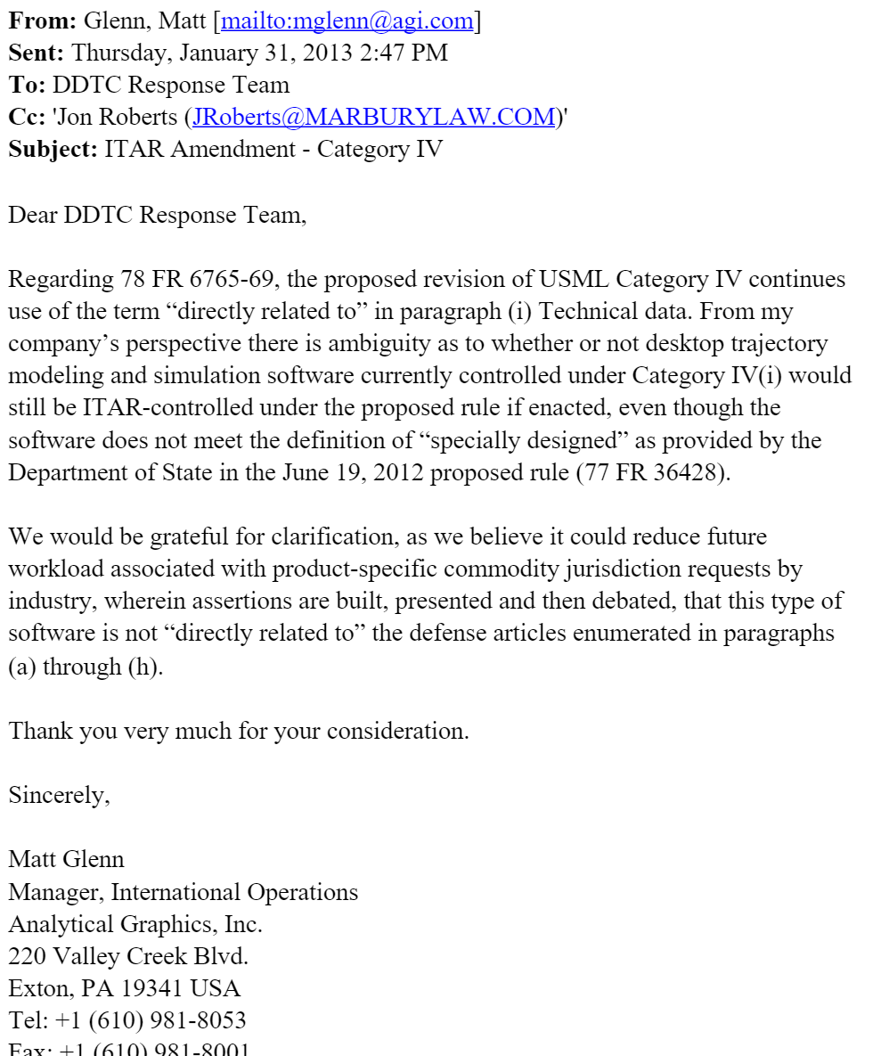
Passive Penetration Results People Search
Recall from the Harvester Results a list of emails.
Second email: mglenn@agi.com
Google Search Term: "mglenn@agi.com”
We find his full name to be “Matt Glenn” – Manager of International Operations.

Slide 22

A Quick Active? Information Gathering Result
Monitor the traffic between our desktop and their web-server.

Slide 23
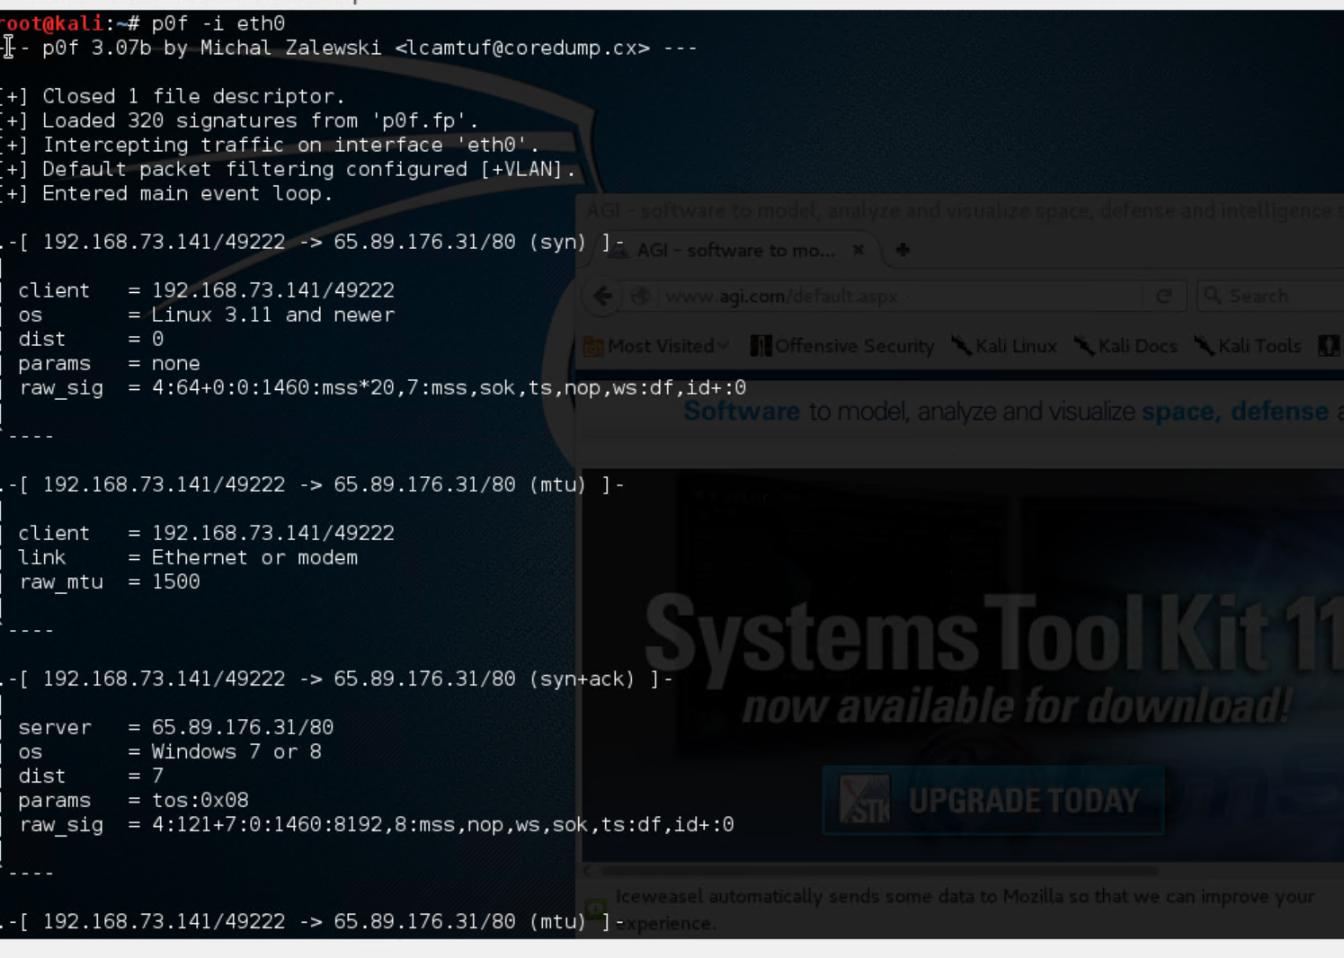
A Quick Active? Information Gathering Result “p0f –i eth0”
P0f -“utilizes an array of sophisticated, purely passive traffic fingerprinting mechanisms to identify the players behind any incidental TCP/IP communications)” (coredump.cx)
Shown is our client computer first contacting the server.

Slide 24
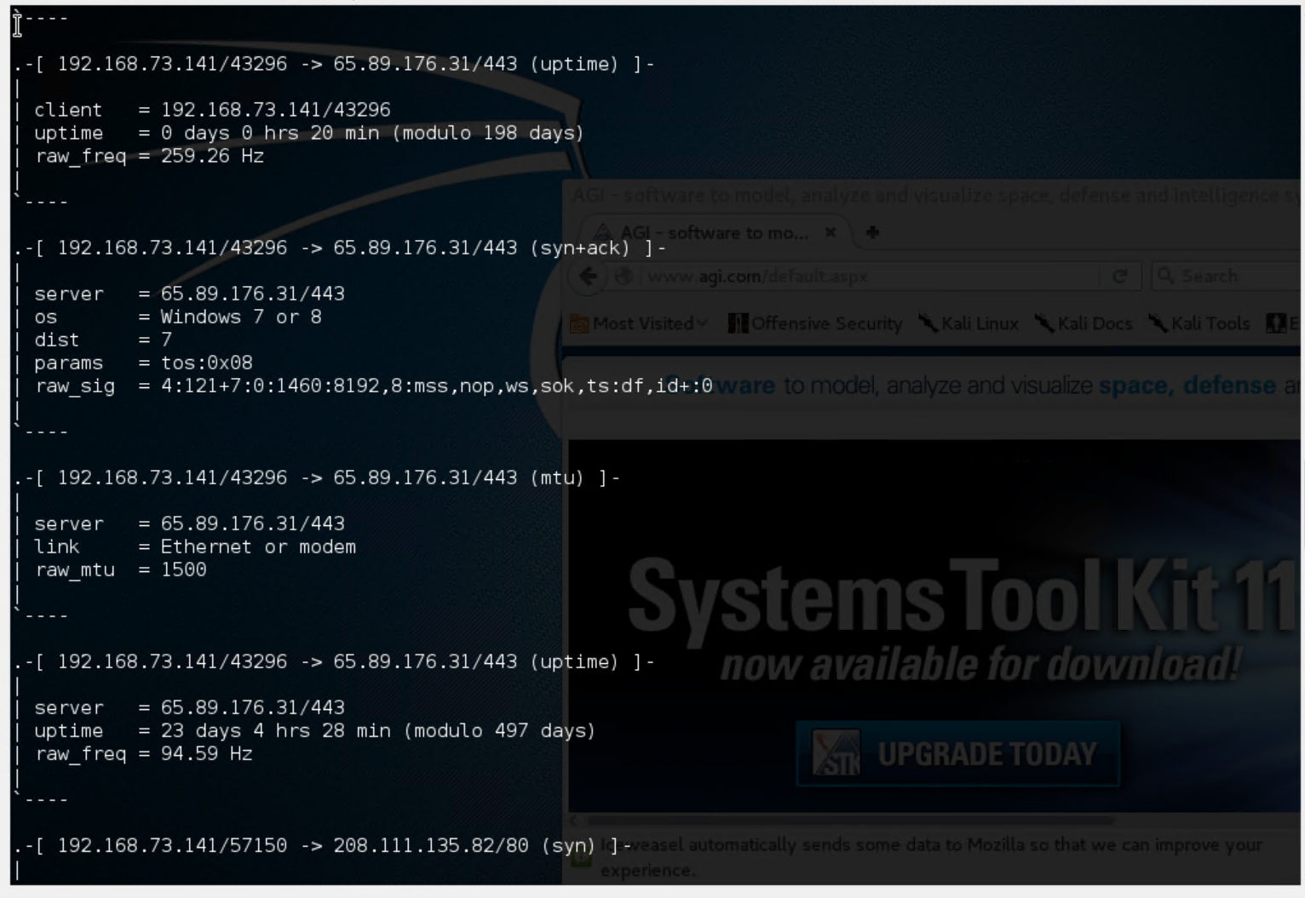
A Quick Active? Information Gathering Result “p0f –i eth0”
After starting the service we connect to the agi.com website to see if we can gather any useful information. We find that the destination server may be using Windows 7/8?
We also see the server has been online for 23 days 4hrs and 28 mins.

Slide 25

Concluding Summary
Wikipedia:
Offices in “Exton, Pennsylvania, [../] Washington, D.C., Colorado Springs, CO, Long Beach, CA, the UK and Singapore”
The Harvester:
Company IP Space - 65.89.176.XXX
Their http service uses a SSL certificate.
They use Amazon cloud services. We can look over their GitHub to see if we can find any special keys that may be uploaded by accident.
A people search resulted in noting Paul Graziani as CEO, David Downs is the Senior Network Administrator, Tim Carrico as a Business Development and Principle Software Engineer at AGI, and Matt Glenn as a Manager of International Operation

Slide 26

Concluding Summary
p0f –i eth0:
Their webserver probably is running a instance of Windows Server 2012.
Their web-server has been up for about 24days.

